Slide 1
Traffic Jam Preventer - An EPN system
Team Members:
Ho Kok Loon Lee Tin Onn Vincent Leung Choong Yue Lin Lee Wai Tong Peter Lei Jun

Slide 2
Agenda
Introduction
Insight Discovery
EPN Design
EPN Evaluation & Conclusion
Demo & Qs

Slide 3
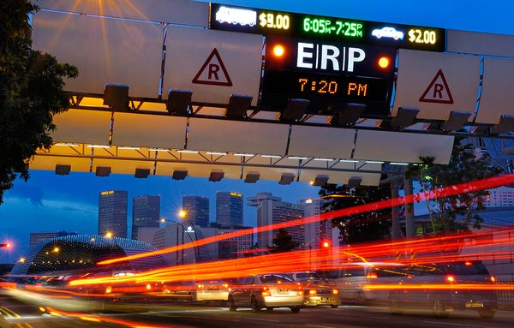
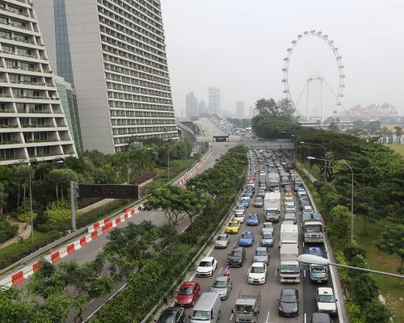
Introduction
Traffic jams
detrimental to health and environment of residents
affect the productivity of a country
take too long on the road
…

Slide 4
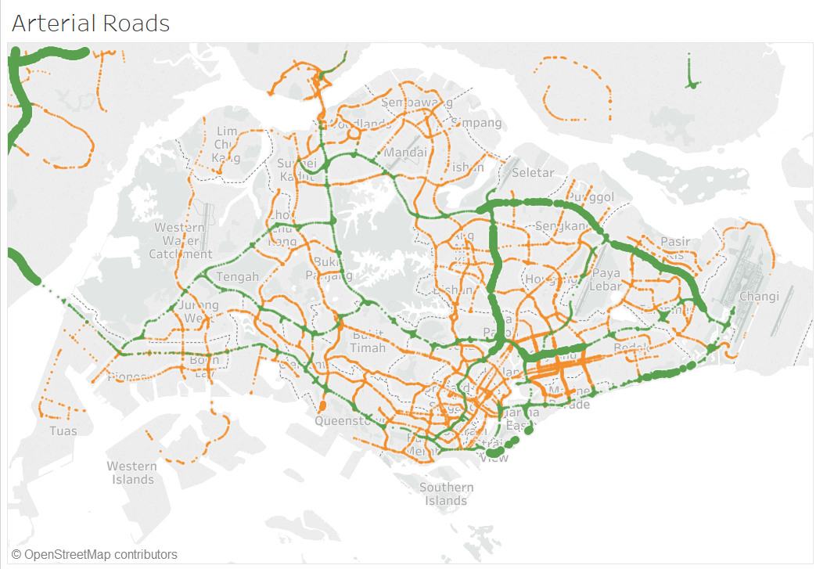
Our solution – an EPN system
EPN: event/message driven system. E.g. accidents, bad weather
By gathering real time traffic data from LTA, weather data from NEA and geospatial data, the system detects the event pattern, analyses, filters and aggregates the data.. And then helps drivers to make decisions.
Weather conditions
Temporal Analysis
Spatial
Accidents
A CEP system

Slide 5
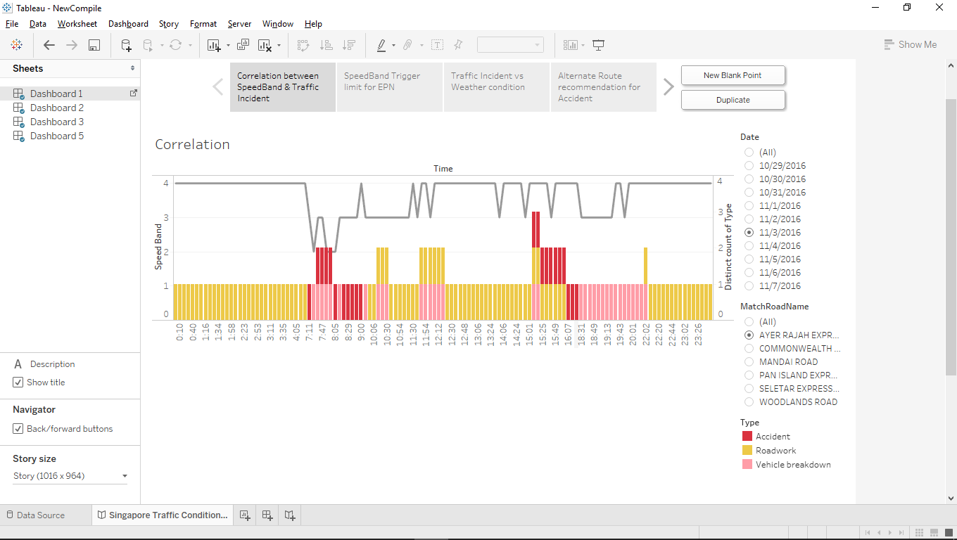
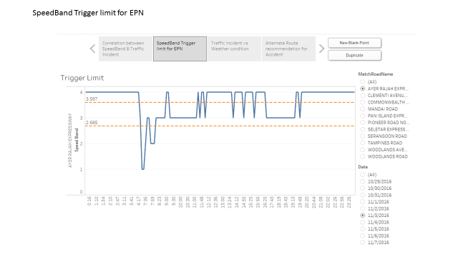
Insight Discovery
Speed versus Road Incidents
When is the worst traffic conditions?

Slide 6
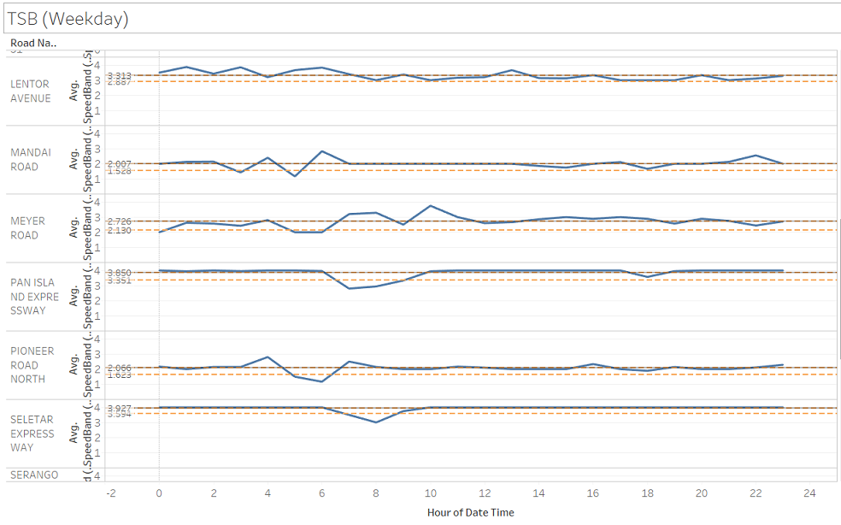
Insight Discovery
Traffic conditions at all arterial roads

Slide 7
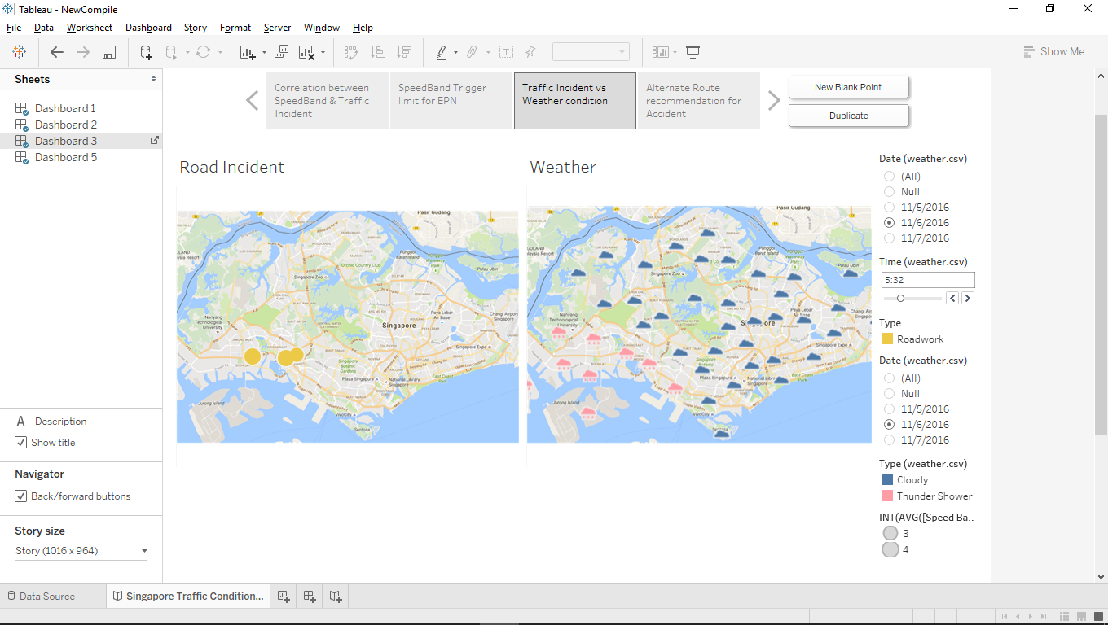
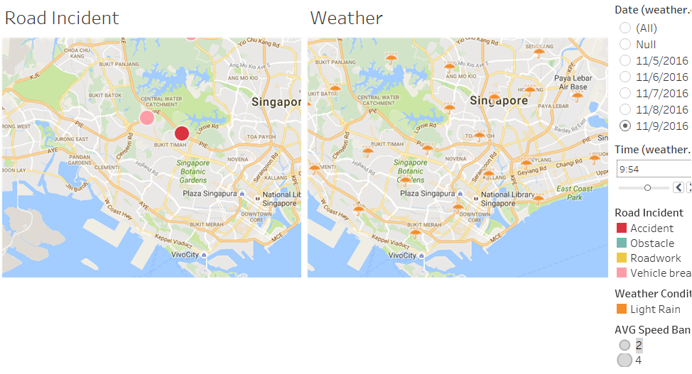
Insight Discovery
Traffic Condition versus Weather Condition

Slide 8
EPN Design
EPA1: Pattern - Temporal
EPA5: Translate
road category = C/B &
previous speed band = 2 &
current speed band = 1
message =“Major Jam at RoadName” exit at AlternativeRoad
EP1
Traffic Speed Bands
Channel1
EPA3: Pattern - Temporal
EPA6: Translate
EC1
road category = C/B &
previous speed band = 3 &
current speed band = 2
message = “Traffic building at” Roadname. “exit at” AlternativeRoad
Expressway Monitoring and Advisory System (EMAS)
EPA3: Pattern - Spatial
EPA7: Translate
EP2
road category = C/B &
current speed band = 2/3 &
Forecast in area =HG/HR/HS/HT
message = “Heavy Rain expect in” Area. Drive with caution”
NEA 2-hr NowCast
Singapore
Geospatial
Database
EP3
EPA4: Filter
EPA8: Translate
Traffic Incidents
message = “Heavy Rain expect in” Area. Drive with caution”
Type = accident/vehicle breakdown/unattended vehicle

Slide 9
EPN Evaluation & Conclusion
Event types
Capture traffic data(LTA), weather data near real time
Event Pattern detection
Filter, aggerate and combine the events with geographic location, average speed
Alert drivers and give suggestions
Event Blocks
Event Type
Event Producer
Event Consumer
Event Processing Agent
Channel
Context
Global State Element

Slide 10

Demo

Slide 11

Questions

